Slide 1
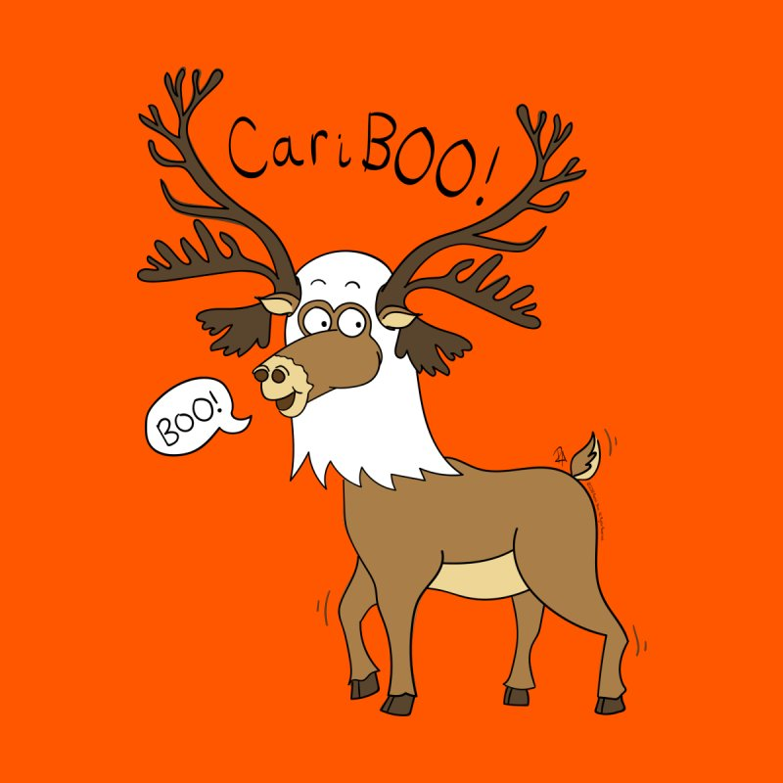
Recitation Tuesday 10/31
Chloe gone next two weeks
Exams on Thursday
Disease ecology hw due next week
Lab today w assignment due Fri
But first….
lambda, matrix models, caribou

Slide 2

R/M Equation $λ= \frac{(1 −M)}{(1 −R)}$ = $\frac{S}{(1 −R)}$
Hatter and Bergerud 1991
does not require knowledge of age structure or age-specific fecundity
often focus on females-only
Notes:
naf includes both breeding adult females and nonbreeding yearlings and subadults, given that the age of first reproduction is >2-years old – but this is OK in the R/M model

Slide 3
Population transition matrix (aka Leslie)
Emphasize proper adjustment of age ratio data using age specific survival and fecundity
square (n x n dimensions)
rows and columns represent age class
top row is number of births coming in from older age classes
lower rows are the number of survivors into the next class
matrix multiplication is simple but tedious… easy in R!

Slide 4
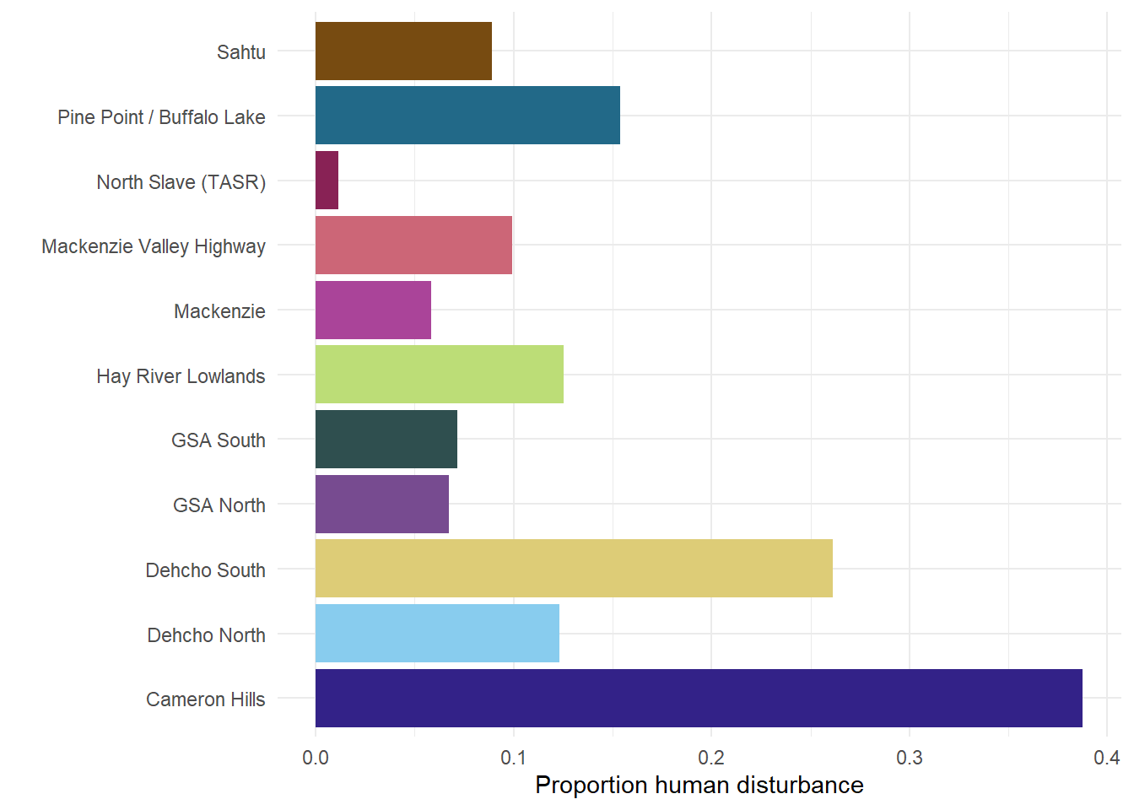
Boreal caribou – National Recovery Strategy
(Canadian) Federal Species at Risk → National Recovery StrategyThreshold ≥ 65% undisturbed habitat
Disturbance = human disturbance buffered by 500m
= areas burned by wildfires ≥ 40 years old
Notes:
(Canadian) Federal Species at Risk → National Recovery Strategy
Threshold ≥ 65% undisturbed habitat

Slide 5
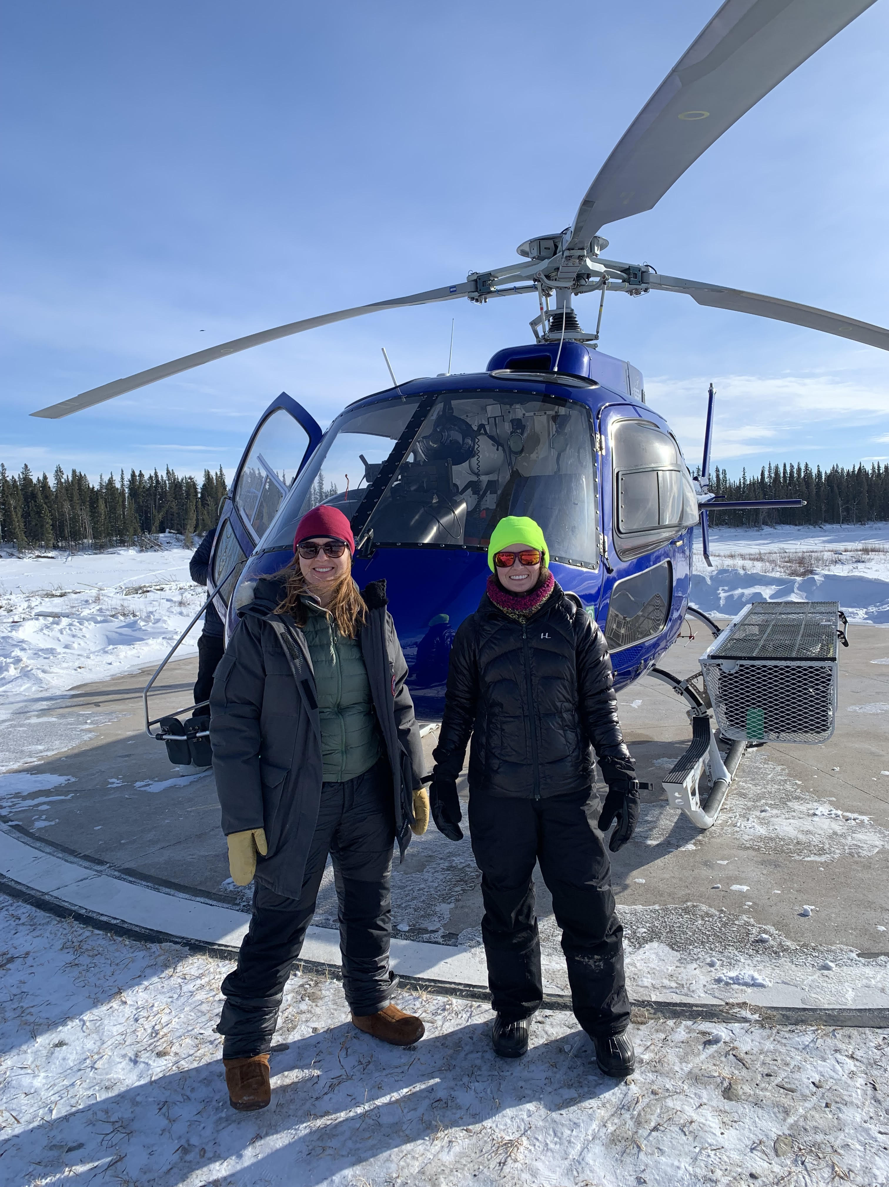
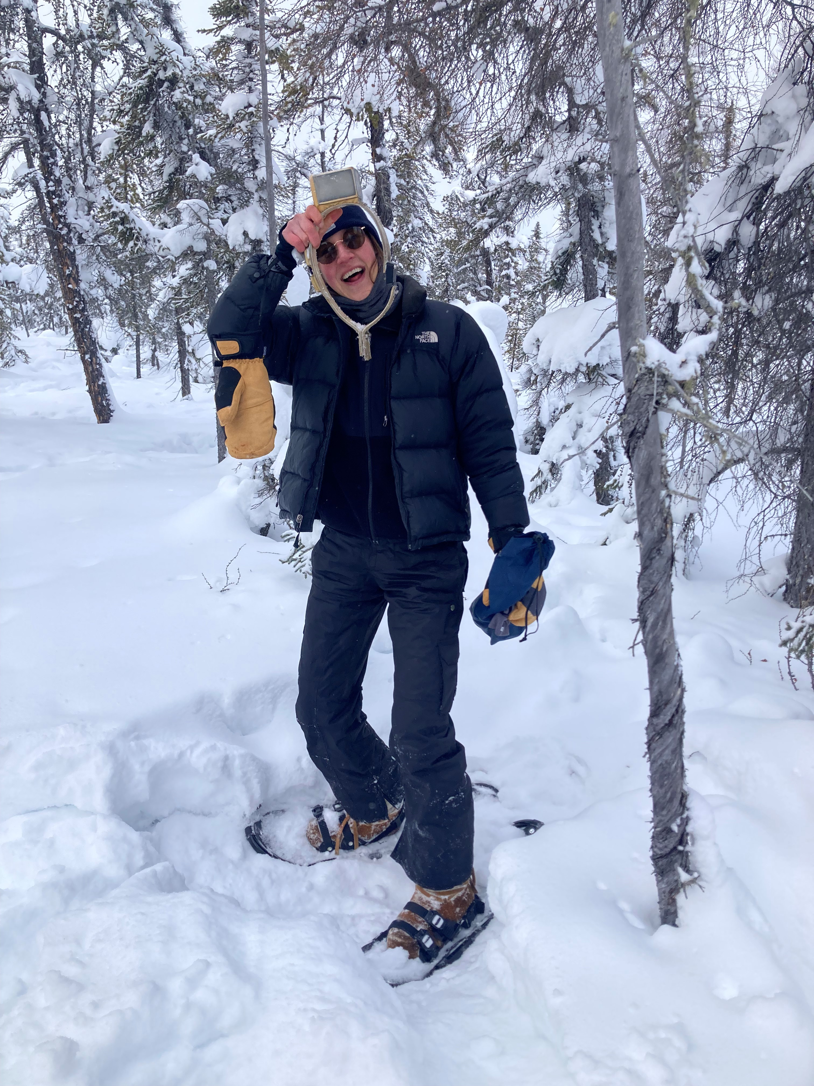
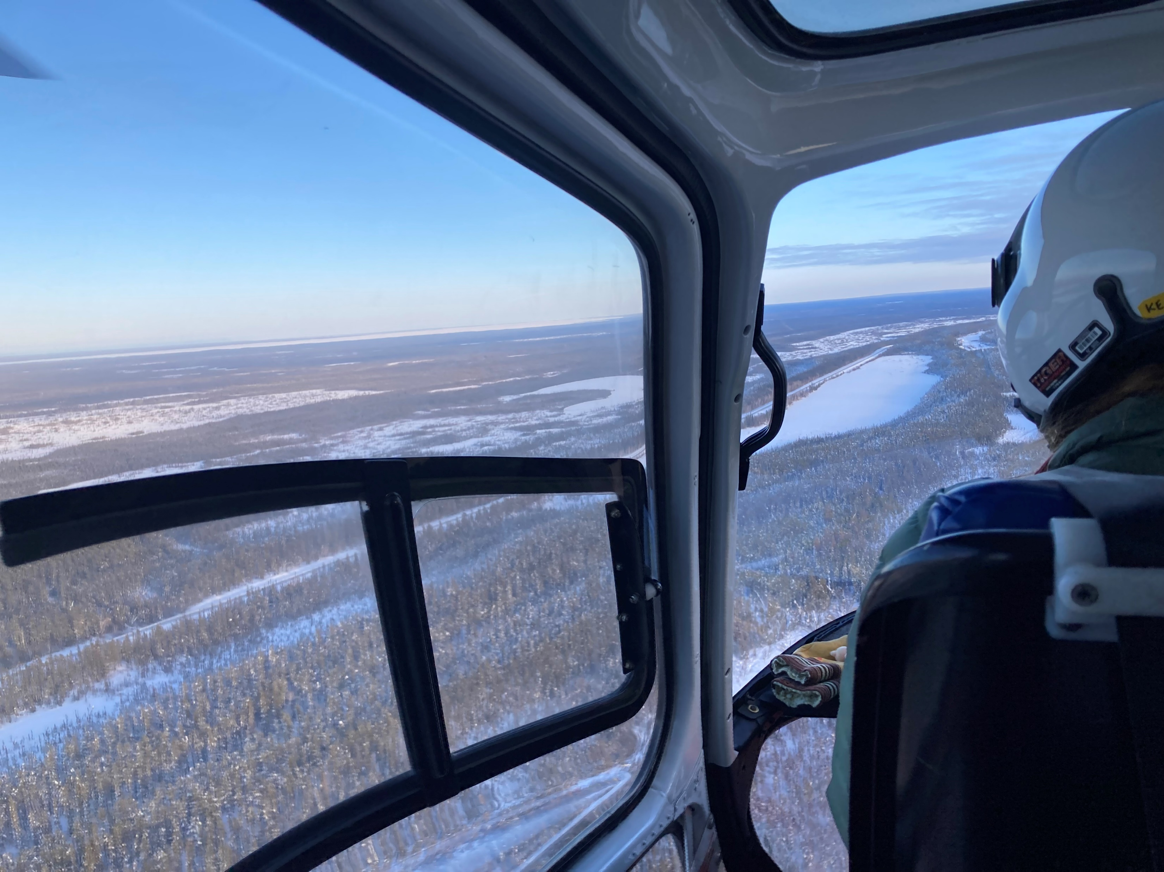
NWT boreal caribou demography
low density, small groups, low sightability
monitor:
survival (VHF and GPS collars)
recruitment (composition surveys)
show study area mapview

Slide 6
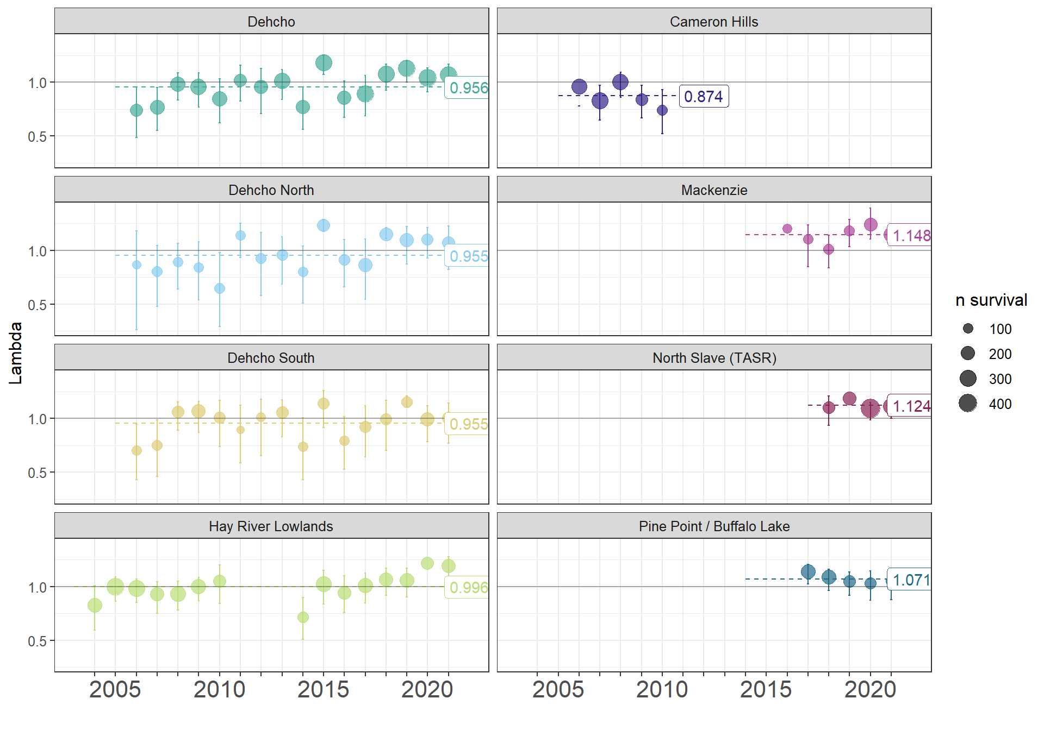
Boreal caribou – Northwest Territories
Does Recovery Strategy framework suit NWT?
Which factors have the greatest impact on boreal caribou survival in NWT?
Notes:
This project will address the suitability of the ECCC recovery strategy framework for boreal caribou in the
NWT, as well as investigate, more broadly, which factors have the greatest impact on boreal caribou survival.
- Does wildfire disturbance influence caribou demographics as much as human disturbance?
- Are we characterizing fire-disturbed habitat in a way that’s relevant for caribou in the NWT?
- Which variables representing high quality habitat influence boreal caribou survival?
- Is weather a stronger determinant of variations in caribou demographics than habitat disturbance?
- Is there strong evidence from the models tested to support a different way of measuring habitat disturbance,
and a different habitat disturbance management threshold, for the NWT?

